Slide 1
Evaluation of Force-Sensing Materials for a Small Robotic Gripper
Anna Martin, Mechanical Engineering
Mentor: Dr. Spring Berman
School for the Engineering of Matter, Transport and Energy
Arizona State University

Slide 2
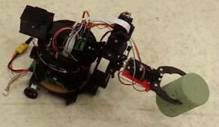
overview
Autonomous robots will have to sense the amount of force their robotic arm applies to an object, determine if that force is too high or too low, and adjust its force output accordingly.
Force Sensing Resistors (FSRs) were previously tested for precision, accuracy, and ease of use and were determined to be too rigid
Cheaper materials, such as velostat, anti-static foam, and neoprene-copper were tested
Applications in robotics: construction and assembly, repairing damaged equipment, load manipulation
Notes:
Test bed finalized

Slide 3
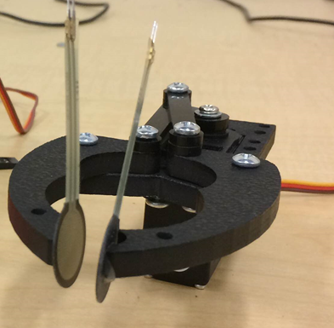
The problem with fSRs
Too rigid
Did not conform to the shape of the manipulator’s jaws
Poor leads did not allow for easy connection to other wires
Led to wires disconnecting during testing, which led to incomplete data
Cost
$14 per sensor
Each manipulator requires 2 sensors, becomes costly for a swarm of robots

Slide 4
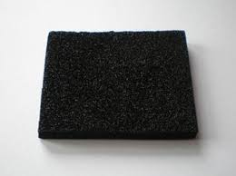
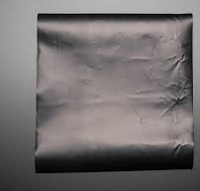
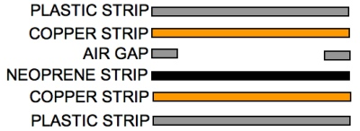
The candidates for the material
Material | Cost | Performance
Anti-static foam | $0.00 because the material was already present in the lab | Large amount of noise (in the MΩ range at times)
Velostat | $0.016 for.71*.71” square | Not as consistent for lower amounts of force; easy to assemble; better if more than one layer is used
Neoprene-copper | $0.079 for .71*.71” square | Difficult to assemble; only conducted on outer edges, most likely due to error in assembly process

Slide 5
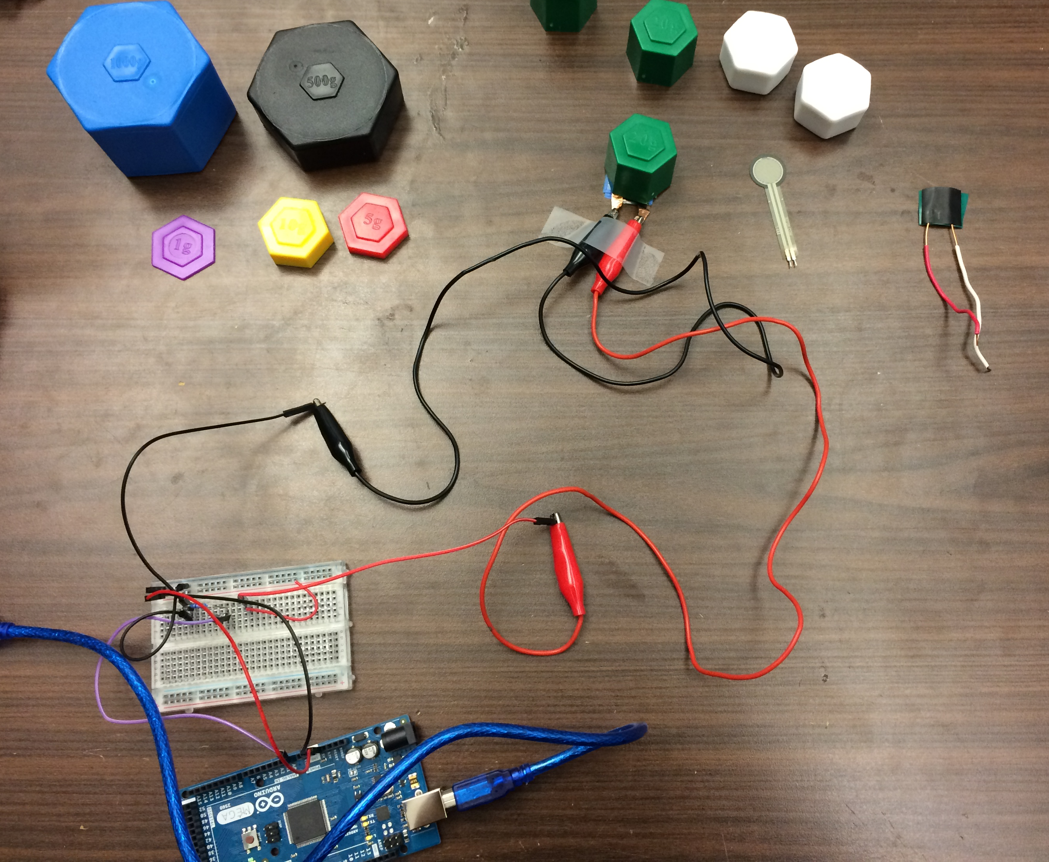
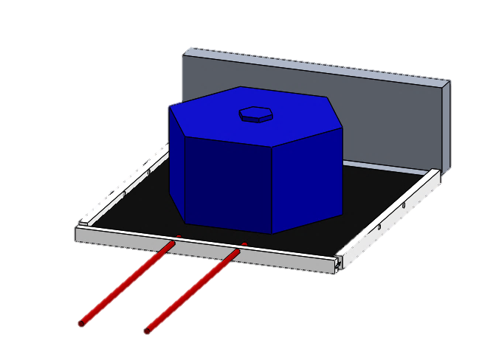
The test bed
Original Design
New Design
Weights
Sensor material
Wires
Material mounts double as wire holders
Arduino Mega

Slide 6
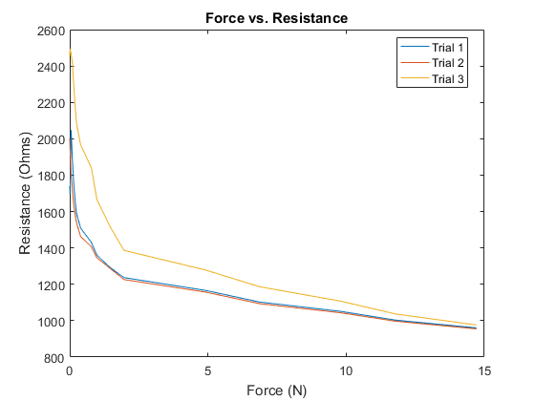
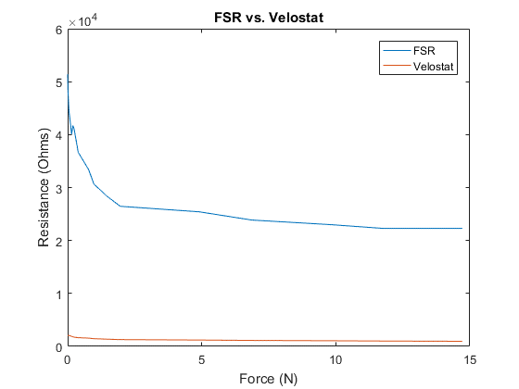
Test bed results for fsr and velostat
Consistency between trials
Comparing materials
Notes:
Curve-fitted equation for 2 layers: R = -21.9556*F + 1.2699e3, F in Newtons, R in Ohms. Solve for F: F = -.045546*R + 57.8395

Slide 7
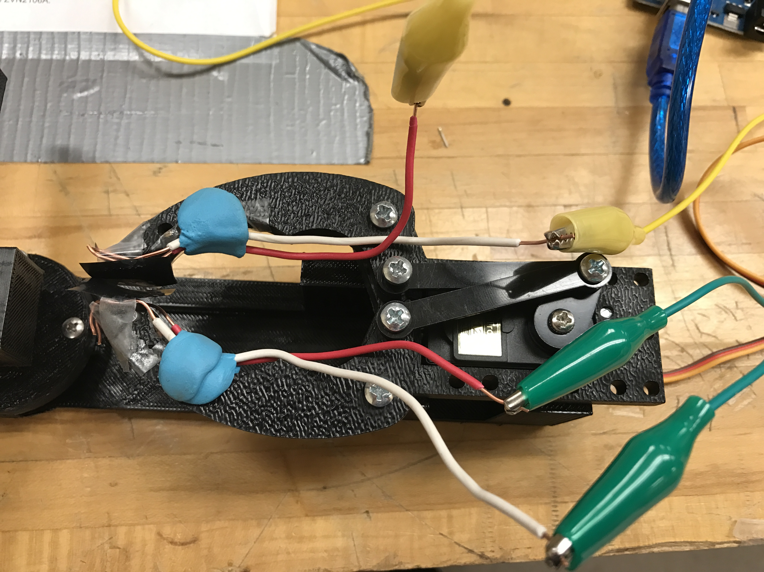
Implementation on a manipulator
Advantages:
Velostat fit the gripper’s jaws well
Wires can be positioned any way
Disadvantages:
Alligator clips added weight to wires and moved them
Wires are still too rigid and would slip out of mounting putty
Difficult to assemble
Had to take apart gripper
Everything would move as soon as it was reassembled

Slide 8
Data comparison between fsrs and velostat sensors
Trial | Average Left FSR Reading | Average Right FSR Reading
1 | 0.330137 | 1.980386
2 | 0.766734 | 3.372041
3 | 4.586414 | 4.69143
4 | 2.401946 | 3.197892
5 | 1.959711 | 4.532586
6 | 2.89983 | 3.64819
7 | 2.054446 | 1.430803
8 | 1.75455 | 3.644629
9 | 2.219138 | 3.862424
10 | 2.626148 | 3.042145
11 | 2.026046 | 2.162665
12 | 2.557159 | 2.281657
13 | 3.070709 | 1.354307
14 | 1.866366 | 1.075359
15 | 3.426502 | 4.778084
FSR
Velostat
The wires from the force sensors kept getting displaced once the manipulator’s jaws squeezed the paddles, so data could not consistently be obtained
When data could be obtained, there were still large variabilities between the readings of the left and right sensors
Likely due to human error in the placing of the sensors

Slide 9
Conclusions and future developments
What I Learned
Future Applications
Consider wires in design
Force-response in various materials is still a research-heavy field
Force sensors made with Velostat are cheaper than traditional FSRs while retaining many properties of FSRs
Because the sensors were hand-made, it was difficult to consistently make them exactly the same, leading to inconsistencies in readings
New jaw design with custom force sensor integrated
Keep wires stationary
Protect Velostat and wiring
More professional look
Force feedback system

Slide 10
acknowledgements
Dr. Spring Berman, Department of Mechanical and Aerospace Engineering
Ruben Gameros, Research Specialist, Department of Mechanical and Aerospace Engineering
Sean Wilson, Ph.D. student, Department of Mechanical and Aerospace Engineering

Slide 11
Questions?

